Slide 1
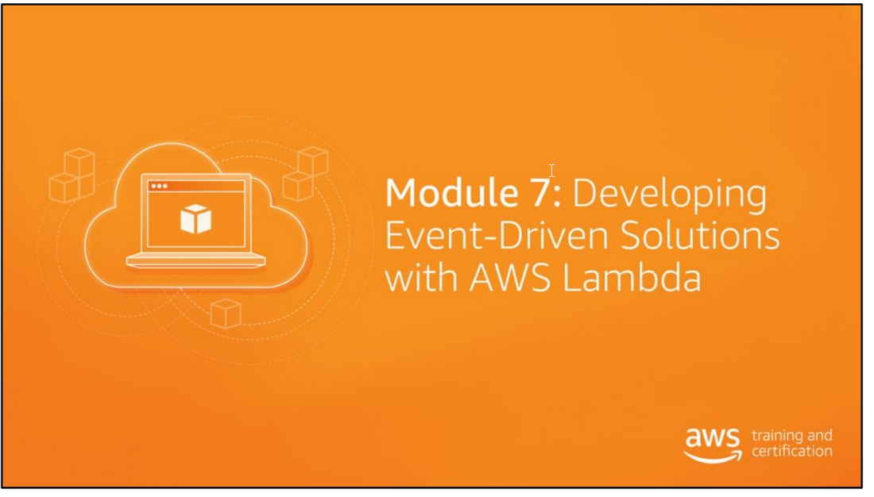

Slide 2
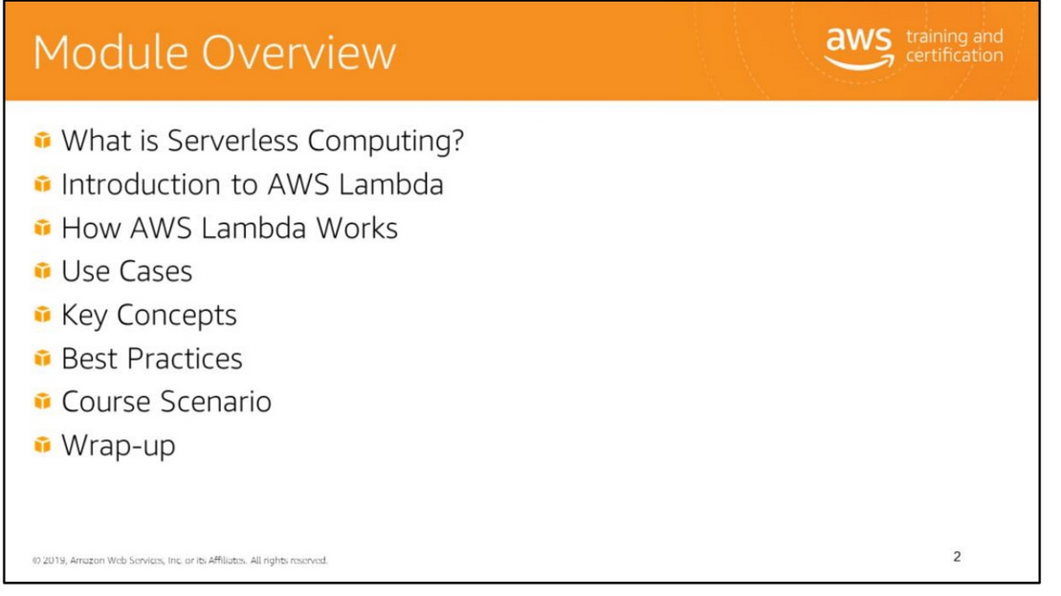

Slide 3


Slide 4
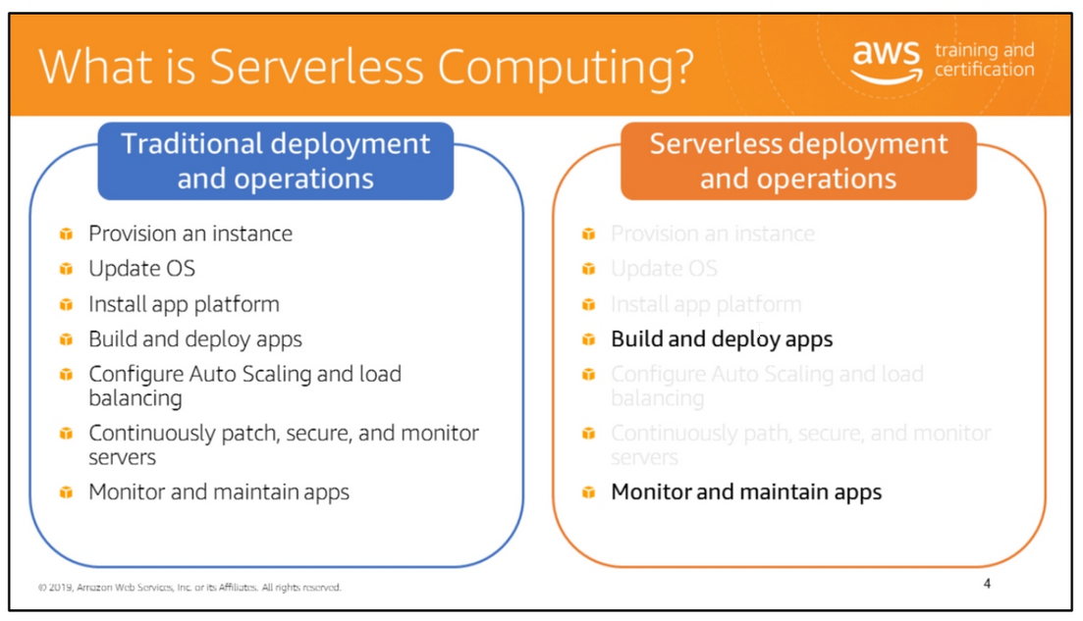
Serverless computing allows you to build and run applications and services without thinking about servers.
Serverless applications don't require you to provision, scale, and manage any servers.
You can build them for nearly any type of application or backend service, and everything required to run and scale your application with high availability is handled for you.
Building serverless applications means that your developers can focus on their core product instead of worrying about managing and operating servers or runtimes, either in the cloud
or on-premises. This reduced overhead lets developers reclaim time and energy that can be spent on developing great products which scale and that are reliable.

Slide 5
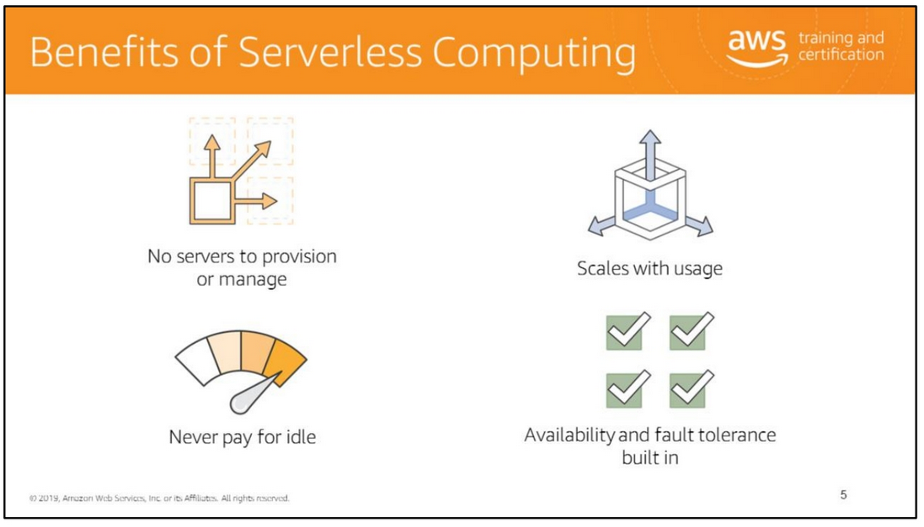
Benefits include the following:
• Never pay for idle, request-based pricing
• No infrastructure to provision, monitor, or manage
• Scaling and fault-tolerance built in
• Easy to author, deploy, and secure
• Enables best practices (events, stateless functions) There is no need to provision or maintain any servers.
There is no software or runtime to install, maintain, or administer.
Your application can be scaled automatically or by adjusting its capacity through toggling the units of consumption (e.g., throughput, memory) rather than units of individual servers.
Serverless applications have built-in availability and fault tolerance. You don't need to architect for these capabilities since the services running the application provide them by default.

Slide 6
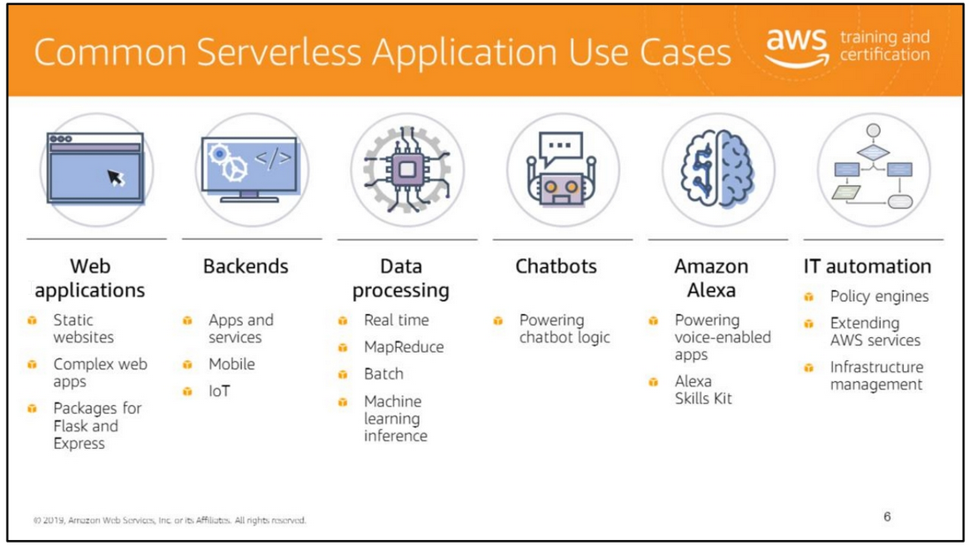
Web applications
By combining AWS Lambda with other AWS services, developers can build powerful web applications that automatically scale up and down and run in a highly available configuration
across multiple data centers – with zero administrative effort required for scalability, back-ups, or multi-data center redundancy.
Backends
You can build serverless backends using AWS Lambda to handle web, mobile, Internet of Things (IoT), and third-party API requests.
Mobile backends
You can build backends using AWS Lambda and Amazon API Gateway to authenticate and process API requests. Lambda makes it easy to create rich, personalized app experiences.
Data processing
You can use AWS Lambda to execute code in response to triggers such as changes in data, shifts in system state, or actions by users.
Lambda can be directly triggered by AWS services such as Amazon S3, Amazon DynamoDB, Kinesis, Amazon SNS, and CloudWatch, or it can be orchestrated into workflows by AWS Step Functions
This allows you to build a variety of real-time serverless data processing systems.
Stream processing
You can use AWS Lambda and Amazon Kinesis to process real-time streaming data for application activity tracking, transaction order processing, click stream analysis, data cleansing,
metrics generation, log filtering, indexing, social media analysis, and IoT device data telemetry and metering.

Slide 7
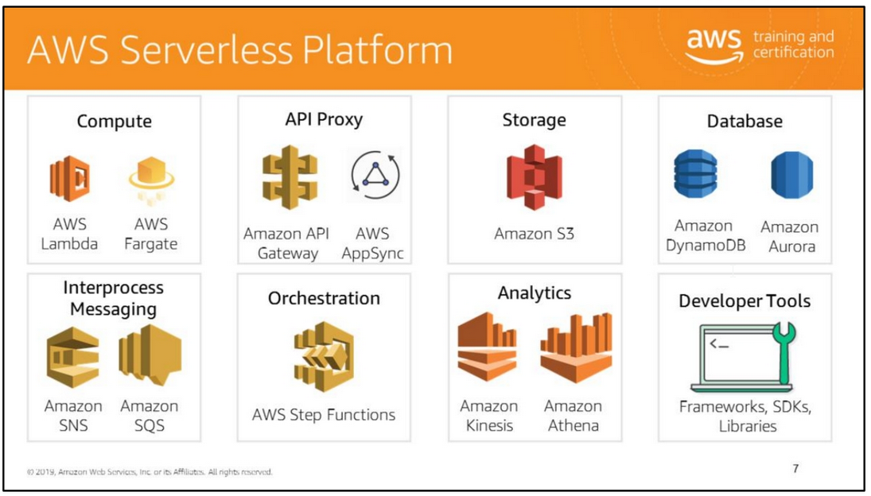
AWS provides a set of fully managed services that you can use to build and run serverless applications.
Serverless applications don’t require provisioning, maintaining, and administering servers for backend components such as compute, databases, storage, stream processing,
queueing, and more. You also no longer need to worry about ensuring application fault tolerance and availability. Instead, AWS handles all of these capabilities for you.
This allows you to focus on product innovation while enjoying faster time-to-market.
For more information, see https://aws.amazon.com/serverless/.

Slide 8
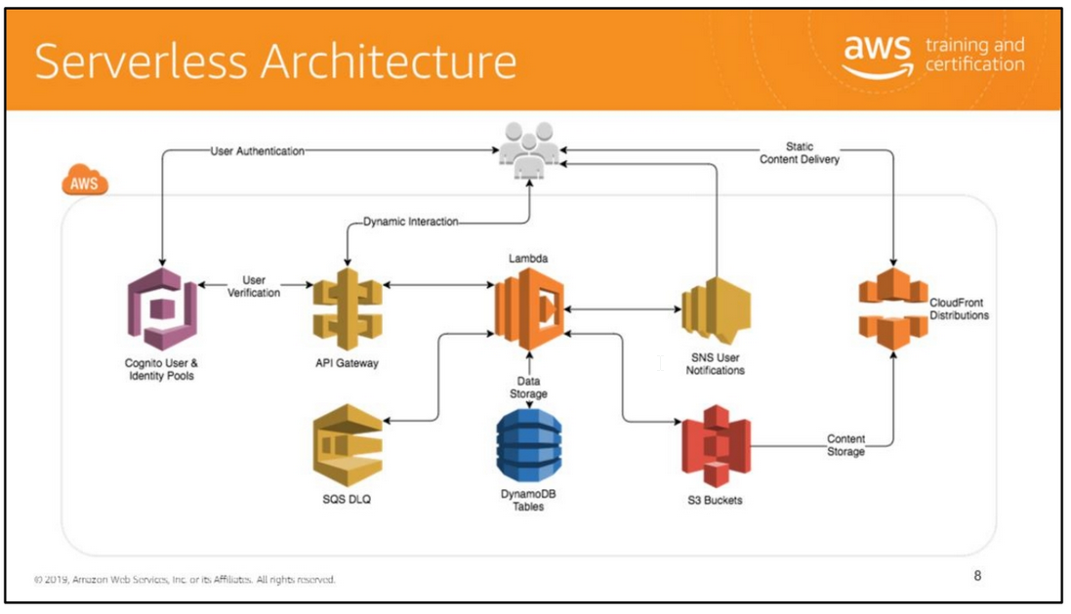

Slide 9
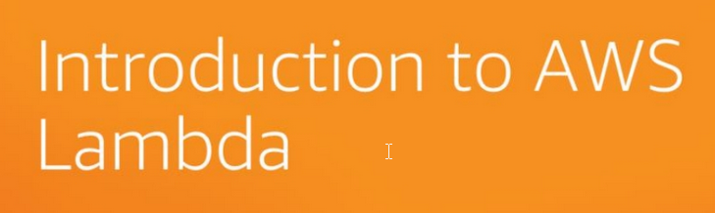

Slide 10
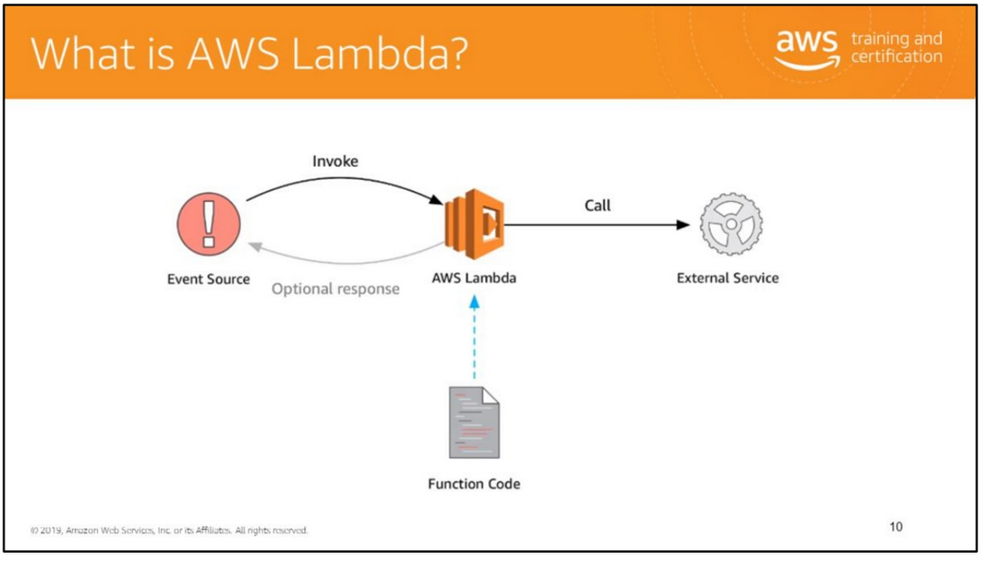
AWS Lambda is a compute service that enables you to run code without provisioning or managing servers.
You pay only for the compute time you consume—there is no charge when your code is not running.
With AWS Lambda, you can run code for virtually any type of application or backend service, all with zero administration.
You need only to upload your code and AWS Lambda manages everything required to run and scale your code with high availability.
You can set up your code to automatically trigger from other AWS services or call it directly from any web or mobile app.
Before using AWS Lambda, you must have an understanding of the following key Lambda concepts:
• Event source – what triggers the call
• Language choice
• Execution environment – permissions and resources
The code you run on AWS Lambda is uploaded as a “Lambda function”.
Each function has associated configuration information, such as its name, description, entry point, and resource requirements.
The code must be written in a “stateless” style i.e. it should assume that there is no affinity to the underlying compute infrastructure.
Local file system access, child processes, and similar artifacts may not extend beyond the lifetime of the request, and any persistent state should be stored in Amazon S3, Amazon DynamoDB,
or another Internet-available storage service. Lambda functions can include libraries, even native ones.
For more information, see https://aws.amazon.com/lambda/.

Slide 11
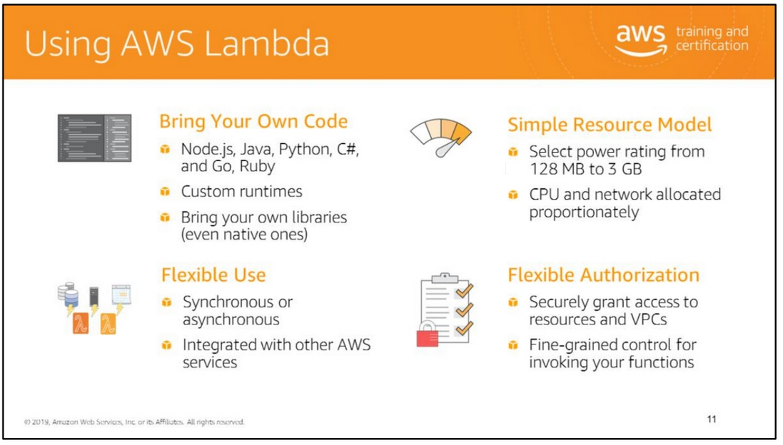
Simple problems deserve simple solutions. Using AWS Lambda, you can ensure that your simple problem is afforded the simple solution it deserves.
AWS Lambda is easy to author, deploy, manage, maintain, scale, pay for, and monitor. It frees you, as a developer, to ensure that your solutions are robust and efficient
without having to manage and maintain the associated infrastructure.
You can implement an AWS Lambda runtime in any programming language.
A runtime is a program that runs a Lambda function's handler method when the function is invoked.
You can include a runtime in your function's deployment package as an executable file named bootstrap.
A runtime is responsible for running the function's setup code, reading the handler name from an environment variable, and reading invocation events from the Lambda runtime API.
The runtime passes the event data to the function handler, and posts the response from the handler back to Lambda.
Your custom runtime runs in the standard Lambda execution environment. It can be a shell script, a script in a language that's included in Amazon Linux,
or a binary executable file that's compiled in Amazon Linux

Slide 12
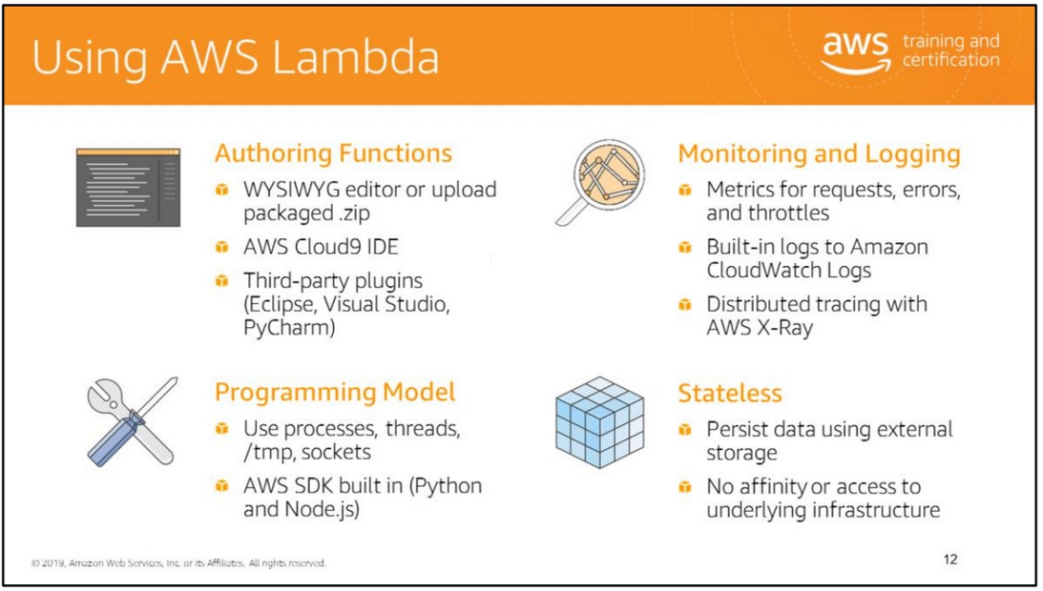

Slide 13
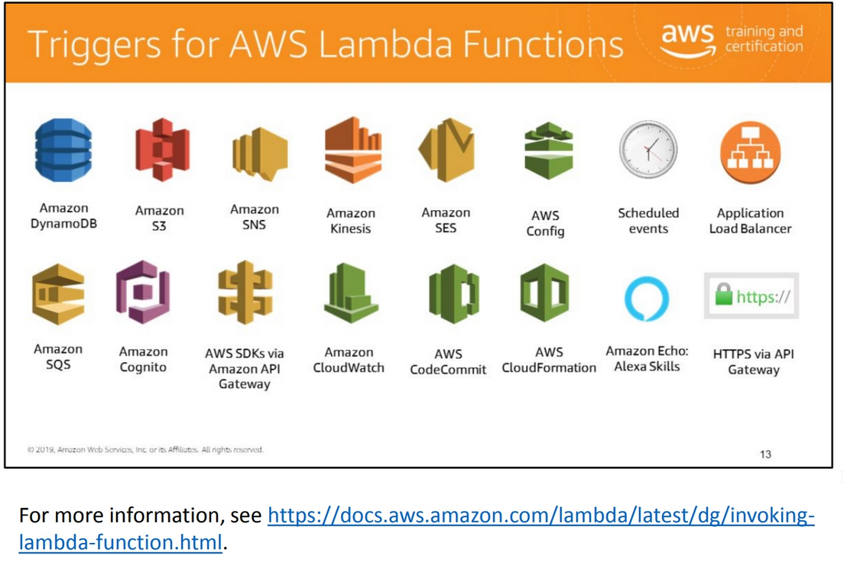

Slide 14


Slide 15
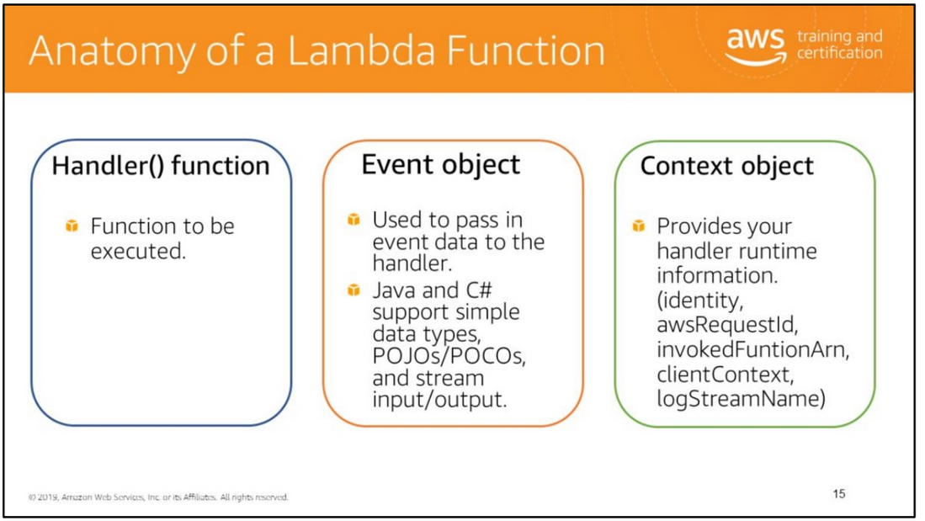

Slide 16
Handler
When a Lambda function is invoked, code execution begins at what is called the handler.
The handler is a specific code method (Java, C#) or function (Node.js, Python) that you’ve created and included in your package.
You specify the handler when creating a Lambda function.
Each language supported by Lambda has its own requirements for how a function handler can be defined and referenced within the package.
Event object
When your Lambda function is invoked in one of the supported languages, one of the parameters provided to your handler function is an event object.
The event differs in structure and contents, depending on which event source created it.
The contents of the event parameter include all of the data and metadata your Lambda function needs to drive its logic.
For example, an event created by API Gateway will contain details related to the HTTPS request that was made by the API client (for example, path, query string, request body),
whereas an event created by Amazon S3 when a new object is created includes details about the bucket and the new object.
Context object
Your Lambda function is also provided with a context object.
The context object allows your function code to interact with the Lambda execution environment.
The contents and structure of the context object vary, based on the language runtime your Lambda function is using, but at minimum it will contain:
• AWS RequestId – Used to track specific invocations of a Lambda function (important for error reporting or when contacting AWS Support).
• Remaining time – The amount of time in milliseconds that remain before your function timeout occurs (Lambda functions can run a maximum of 300 seconds as of this publishing,
but you can configure a shorter timeout).
• Logging – Each language runtime provides the ability to stream log statements to Amazon CloudWatch Logs.
The context object contains information about which CloudWatch Logs stream your log statements will be sent to.

Slide 17
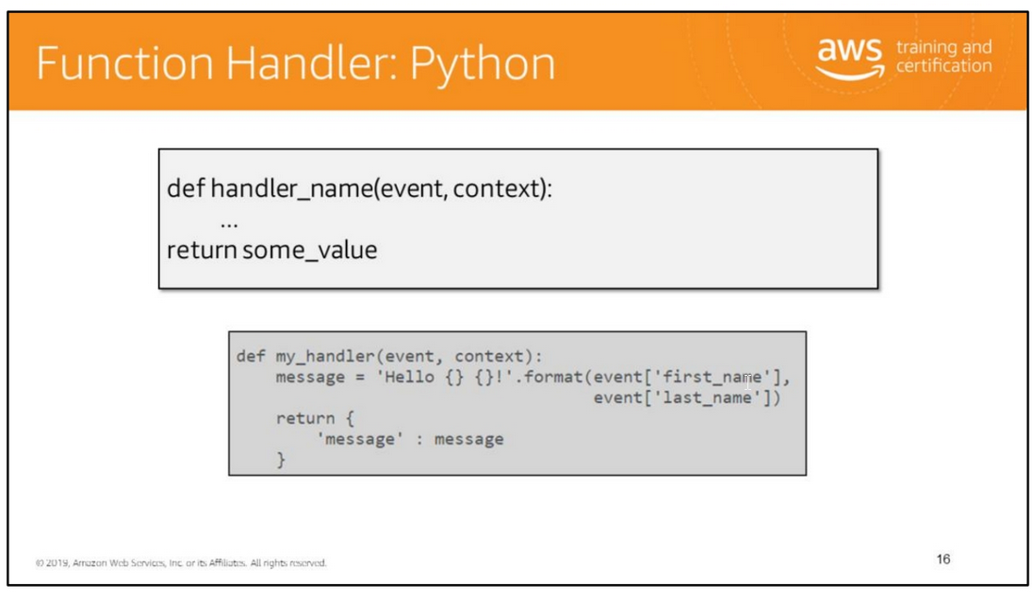
Handler is a function that calls to start your AWS Lambda function. AWS Lambda passes any event data to handler function as the first parameter.
Your handler should process the event data and may invoke any other functions or methods in your code.
This example has one function called my_handler. The function returns a message containing data from the event it received as input.

Slide 18
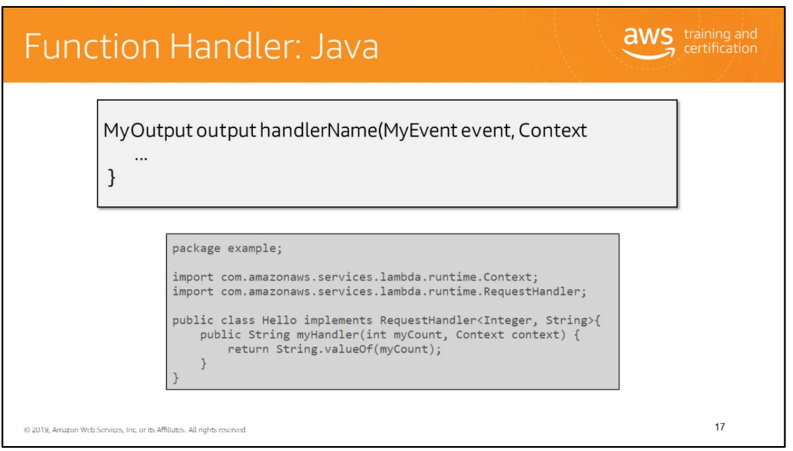
In this example input is of type Integer and output is of type String.
If you package this code and dependencies, and create your Lambda function, you specify example.Hello::myHandler (package.class::method-reference) as the handler.
In the example Java code, the first handler parameter is the input to the handler (myHandler), which can be event data (published by an event source such as Amazon S3)
or custom input you provide such as an Integer object (as in this example) or any custom data object

Slide 19
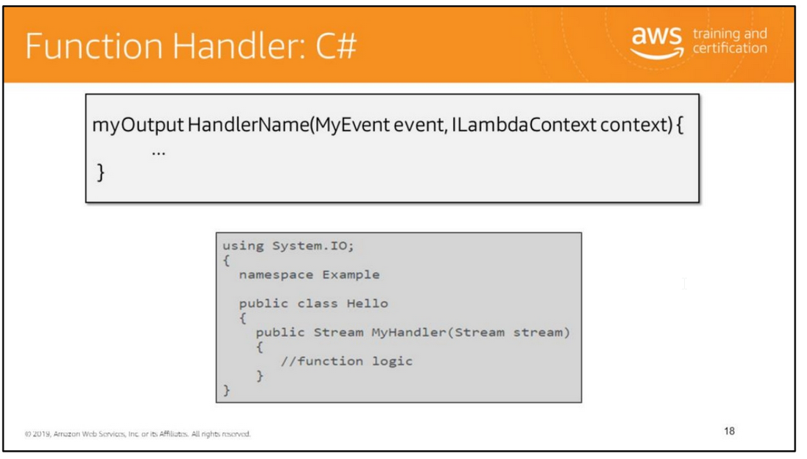
When you create a Lambda function, you specify a handler that AWS Lambda can invoke when the service executes the function on your behalf.
You define a Lambda function handler as an instance or static method in a class.
If you want access to the Lambda context object, it is available by defining a method parameter of type ILambdaContext, an interface you can use to access information
about the current execution, such as the name of the current function, the memory limit, execution time remaining, and logging.
In the example C# code, the first handler parameter is the input to the handler (MyHandler), which can be event data (published by an event source such as Amazon S3)
or custom input you provide such as a Stream (as in this example) or any custom data object. The output is of type Stream.

Slide 20
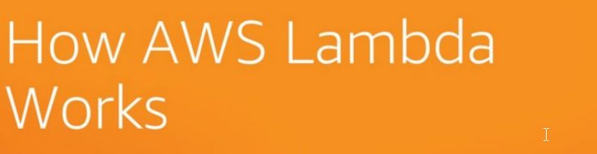

Slide 21
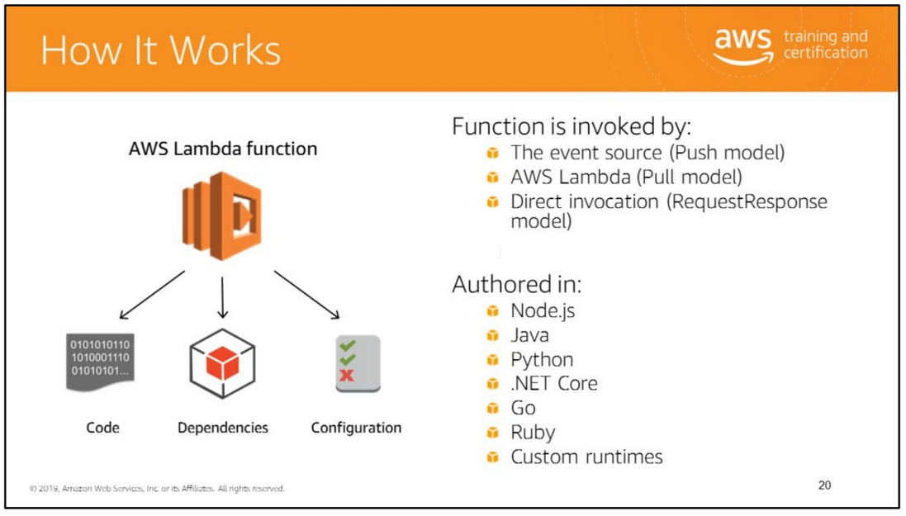

Slide 22
The core components of AWS Lambda are the Lambda function and an event source.
Event sources publish events, and a Lambda function is the custom code that you write to process the events.
AWS Lambda executes your Lambda function on your behalf. A Lambda function consists of your code, associated dependencies, and configuration.
Configuration includes information such as the handler that will receive the event, the AWS Identity and Access Management (IAM) role AWS Lambda can assume to execute
the Lambda function on your behalf, the compute resource you want allocated, and the execution timeout.
How a Lambda function is invoked depends on the event source that you use with it.
Event-based invocation
Some event sources can publish events to AWS Lambda and directly invoke your Lambda function.
This is called the push model where the event sources invoke your Lambda function.
Some event sources publish events, but AWS Lambda must poll the event source and invoke your Lambda function when events occur.
This is called the pull model.
Request-response invocation
This invocation type causes AWS Lambda to execute the function synchronously and returns the response immediately to the calling application.
This invocation type is available for custom applications.
Lambda functions are authored in Node.js, Java, .NET Core, Go, Ruby, and Python.
Your code can include existing libraries, even native ones. For more information, see https://docs.aws.amazon.com/lambda/latest/dg/current-supported-versions.html.
For the latest compatibility information, see: https://docs.aws.amazon.com/lambda/latest/dg/lambda-runtimes.htm

Slide 23
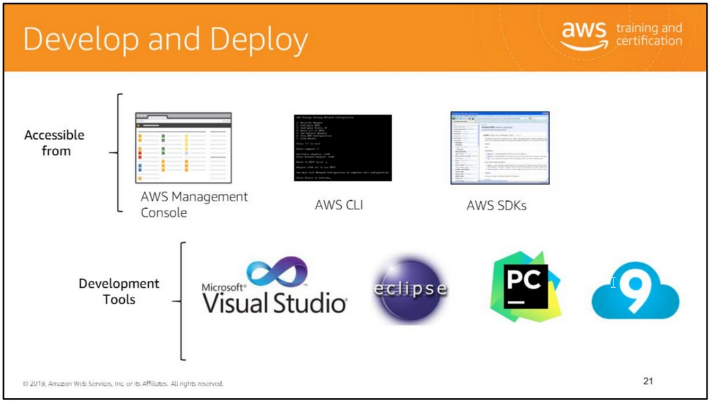
For more information, see:
• AWS Toolkit for Eclipse: http://docs.aws.amazon.com/AWSToolkitEclipse/latest/GettingStartedGuide/lamb da.html
• AWS Toolkit for Visual Studio: https://blogs.aws.amazon.com/net/post/Tx381XNNQALP8BA/AWS-Lambda-Support-in-Visual-Studio
• AWS Toolkit for PyCharm: https://plugins.jetbrains.com/plugin/11349-aws-toolkit

Slide 24
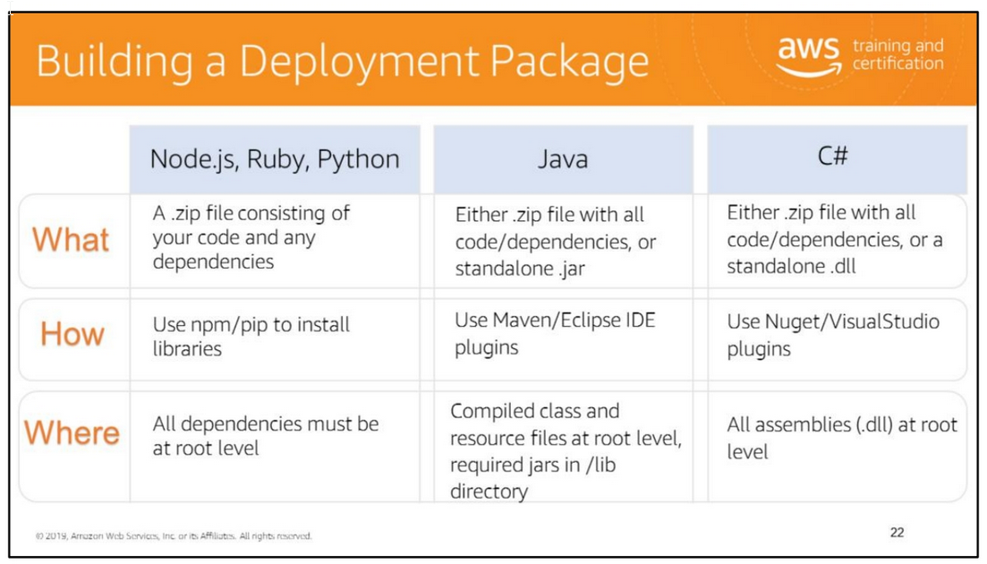
Node.js, Ruby, and Python
To create a Lambda function, you first create a Lambda function deployment package, a .zip file consisting of your code and any dependencies.
You will then need to set the appropriate security permissions for the zip package. Zip the directory content contained within the directory, not the directory itself.
The contents of the Zip file are available as the current working directory of the Lambda function. For example: /project-dir/codefile.py/lib/yourlibraries.
In this case, you zip the content contained within /project-dir.
Java
Your deployment package can be a .zip file or a standalone jar; it is your choice.
You can use any build and packaging tool you are familiar with to create a deployment package.
C#
A .NET Core Lambda deployment package is a zip file of your function's compiled assembly along with all of its assembly dependencies.
The package also contains a proj.deps.json file. This signals to the .NET Core runtime all of your function's dependencies and a proj.runtimeconfig.json file,
which is used to configure the .NET Core runtime. The .NET CLI publish command can create a folder with all of these files, but by default the proj.runtimeconfig.json
will not be included because a Lambda project is typically configured to be a class library.
To force the proj.runtimeconfig.json to be written as part of the publish process, pass in the command line argument: /p:GenerateRuntimeConfigurationFiles=true to the publish command.

Slide 25
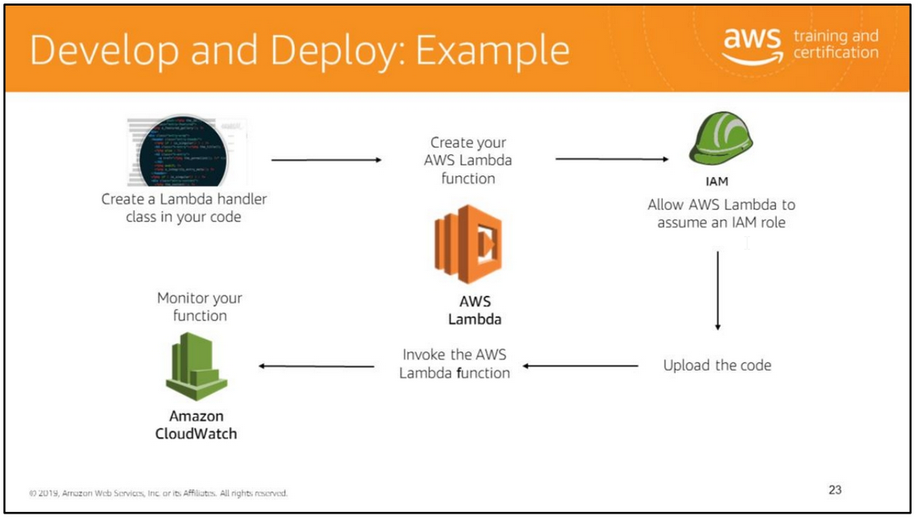
The slide illustrates the process of developing and deploying an AWS Lambda function with dependencies.
There are three ways to deploy an AWS Lambda function:
• If your code does not require custom libraries (other than the AWS SDK), edit your code inline through the AWS Management Console.
The console will zip up your code with the relevant configuration information into a deployment package that the Lambda service can run.
This is the ideal deployment choice for simple scenarios.
• In an advanced scenario where your code requires custom libraries, you can upload a .ZIP file of your code and all of its dependencies through the AWS Management Console or the AWS CLI.
• You can also create your Lambda deployment package (.ZIP) and upload it to an S3 bucket, and AWS Lambda loads your code directly from Amazon S3.
In a call to CreateFunction or UpdateFunctionCode, you can now provide the S3 bucket, key (object name), and optional version as an alternative to supplying the code directly,
and Lambda loads your code directly from Amazon S3. If the bucket owner and the user making these calls aren’t the same, make sure the latter has permission to read the file.
The S3Bucket, S3Key, and S3ObjectVersion must be specified. Within the AWS Lambda console, select Upload a .ZIP from S3

Slide 26
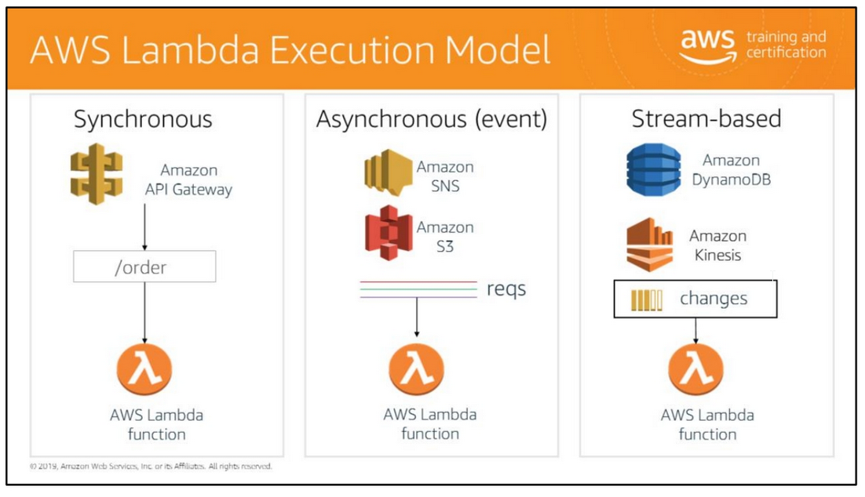

Slide 27
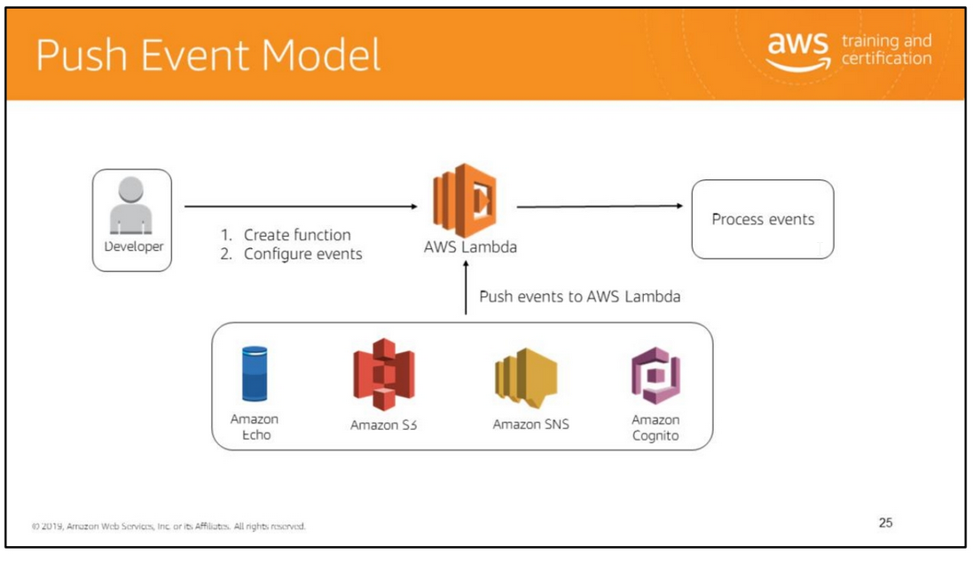
The Event invocation type uses the push event model:
• An event source directly invokes a Lambda function when it publishes an event.
• The push model applies to Amazon S3, Amazon SNS, Amazon Cognito, Amazon Echo, and user applications, where each individual event triggers the Lambda function.
• You need to grant the event source necessary permissions to invoke the Lambda function via the access policy associated with the function (Permissions discussed on next slide).
AWS Lambda does not explicitly manage event sources in this model. You do not use the AWS Lambda APIs to map your Lambda function to its event source.
Instead, you use APIs from the event source to configure this mapping.
For example, if Amazon S3 is your event source, you would specify event source mapping as part of bucket notification configuration.
Note: For your convenience, the AWS Lambda console shows all event sources (pull and push) for a given function.
Amazon S3, Amazon SNS, Amazon Cognito, and Amazon Echo invoke the Lambda function using the Event invocation type in the invoke API call.
User applications can invoke the Lambda functions by using the Event invocation type, the "RequestResponse" invocation type, or the “DryRun” invocation type.
For more information, see http://docs.aws.amazon.com/lambda/latest/dg/API_Invoke.html.

Slide 28
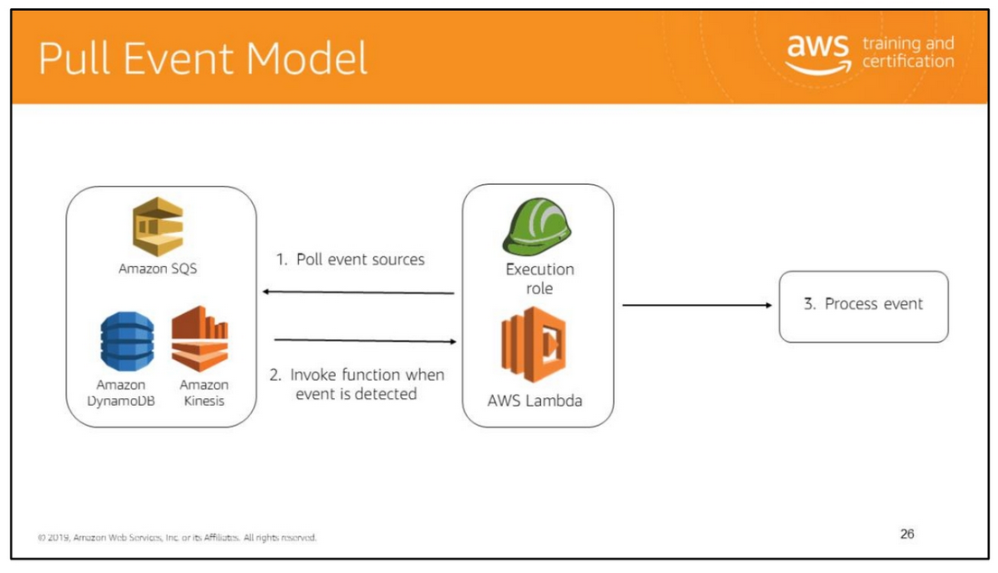
In the pull event model, AWS Lambda polls the event source and invokes your Lambda function when it detects an event.
This model applies when AWS Lambda is used with streaming event sources such as Amazon Kinesis and DynamoDB streams.
For example, AWS Lambda polls your Amazon Kinesis stream, or Amazon DynamoDB stream, and invokes your Lambda function when it detects new records on the stream.
In this model, AWS Lambda manages the event source mapping.
That is, it provides an API for you to create event source mappings that associate your Lambda function with a specific event source.
For more information, see http://docs.aws.amazon.com/lambda/latest/dg/API_CreateEventSourceMapping.htm l.
You must grant AWS Lambda the necessary permissions to access the event source via an IAM role

Slide 29
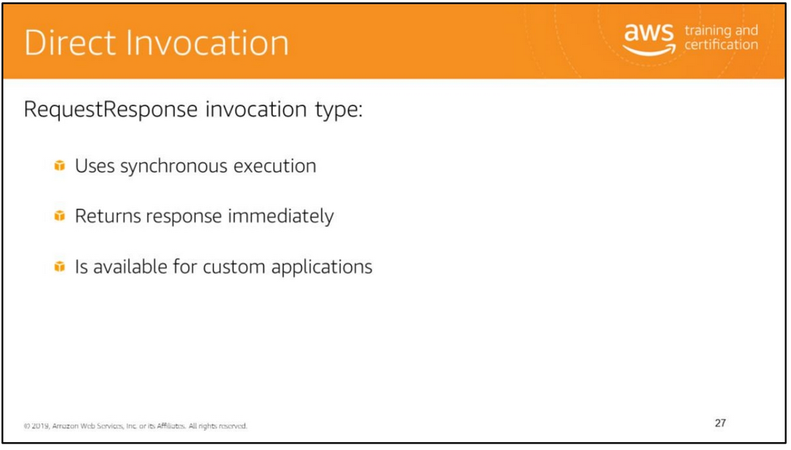
The RequestResponse invocation type:
• Causes AWS Lambda to execute the function synchronously and returns the response immediately to the calling application letting you know whether the invocation happened.
• Is available for custom applications.
For more information, see http://docs.aws.amazon.com/lambda/latest/dg/API_Invoke.html

Slide 30
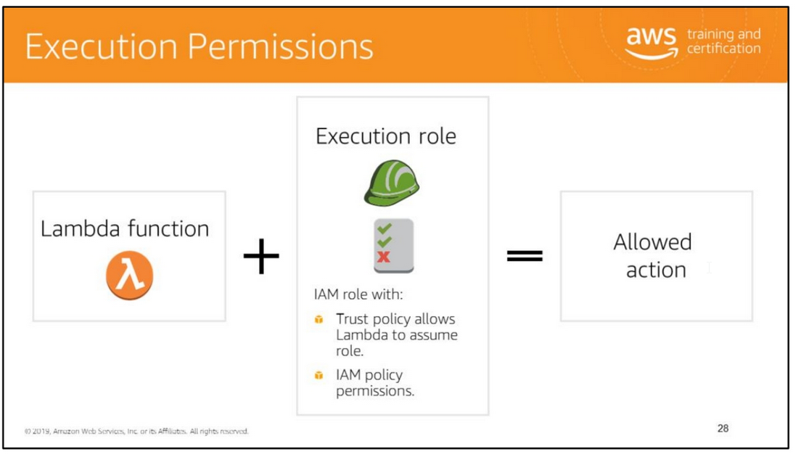
There are two types of permissions related to Lambda functions:
• Execution permissions: The permissions that your Lambda function needs to access other AWS resources in your account.
You grant these permissions by creating an IAM role, known as an execution role. Execution roles determine what your function can do.
• Invocation permissions: The permissions that the event source needs to communicate with your Lambda function.
Depending on the invocation model (push or pull model), you can grant these permissions using either the execution role or resource policies (the access policy associated
with your Lambda function). Invocation roles determine who can execute your function.
Note: If the user-defined application and the Lambda function it invokes belong to the same AWS account, you don’t need to grant explicit permissions.
For more information, see http://docs.aws.amazon.com/lambda/latest/dg/intro-permission-model.html

Slide 31
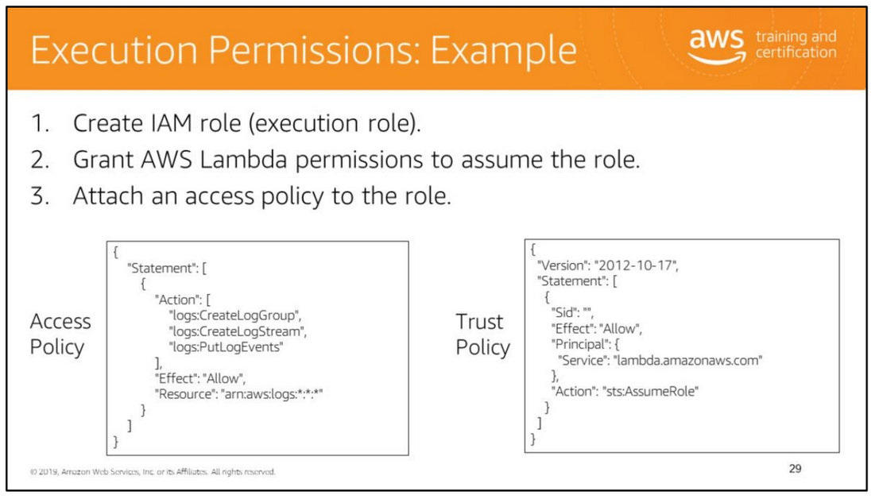
Diving deeper into AWS Lambda permissions, when your Lambda function is executed, it can access other AWS resources in your account such as your S3 buckets, CloudWatch Logs,
and Amazon Kinesis streams, but you must grant the necessary permissions. You must create an execution role through IAM, grant AWS Lambda permission to assume the role,
and attach an access policy to the role that grants needed permissions.
Each IAM role has two policies attached:
• Access policy: Grants your Lambda function the resource permissions it needs. (Access policy example: if your Lambda function writes logs for your function to Amazon CloudWatch Logs,
you grant permissions for the CloudWatch Logs actions to create a log group and log stream and write to the log stream as shown.)
• Trust policy: Identifies who can assume the role. (Trust policy example: AWS Lambda service principal assumes the role.)
Important: The user who is creating the IAM role is granting permission to AWS Lambda to assume this role. To grant permission, the user must have permission for the iam:PassRole action.
Administrators have full permissions, including the iam:PassRole.
For more information, see:
• Specifying permissions in a policy: http://docs.aws.amazon.com/AmazonS3/latest/dev/using-with-s3-actions.html
• Roles - delegation and federation: http://docs.aws.amazon.com/IAM/latest/UserGuide/roles-toplevel.html

Slide 32
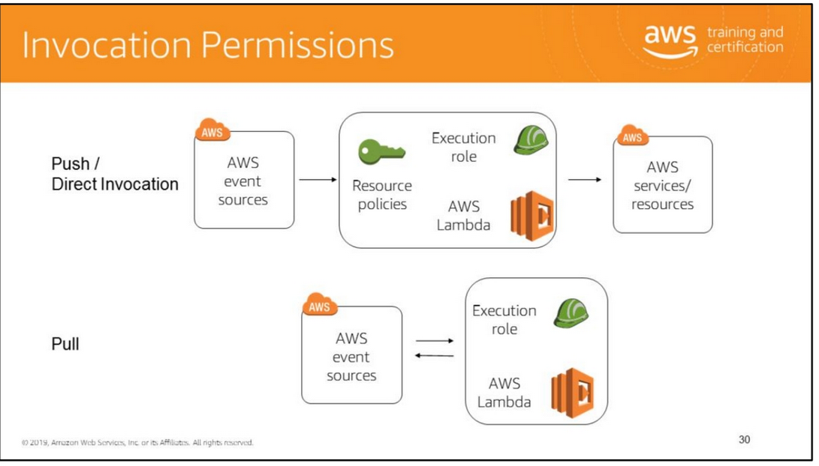
There are two types of permissions related to Lambda functions:
• Execution permissions: The permissions that your Lambda function needs to access other AWS resources in your account.
You grant these permissions by creating an IAM role, known as an execution role.
• Invocation permissions: The permissions that the event source needs to communicate with your Lambda function.
Depending on the invocation model (push or pull model), you can grant these permissions using either the execution role or resource policies
(the access policy associated with your Lambda function).
Note: If the user-defined application and the Lambda function it invokes belong to the same AWS account, you don’t need to grant explicit permissions.
For more information, see http://docs.aws.amazon.com/lambda/latest/dg/intro-permission-model.htm

Slide 33
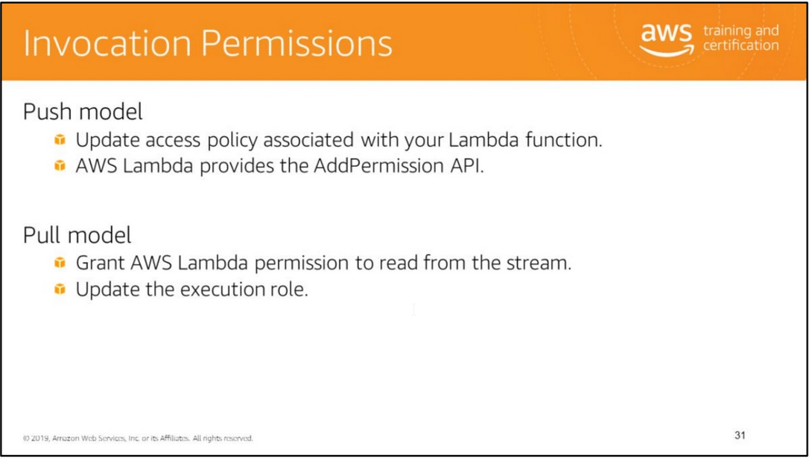
The entity that invokes your Lambda function must have permission to do so.
In the push model, the event source (such as Amazon S3 or a user-defined application) invokes your Lambda function by publishing events.
• You grant these event sources permissions to invoke your Lambda function by updating the access policy associated with your Lambda function.
• AWS Lambda provides the AddPermission API for this purpose.
For more information, see http://docs.aws.amazon.com/lambda/latest/dg/API_AddPermission.html.
Note: If the user-defined application and the Lambda function it invokes belong to the same AWS account, you don’t need to grant explicit permissions.
In the pull model, AWS Lambda invokes your Lambda function but it needs to read your event sources (such as a Kinesis stream or a DynamoDB stream).
• You must grant AWS Lambda permission to read from the stream.
• You do this by updating the execution role associated with your Lambda function.

Slide 34
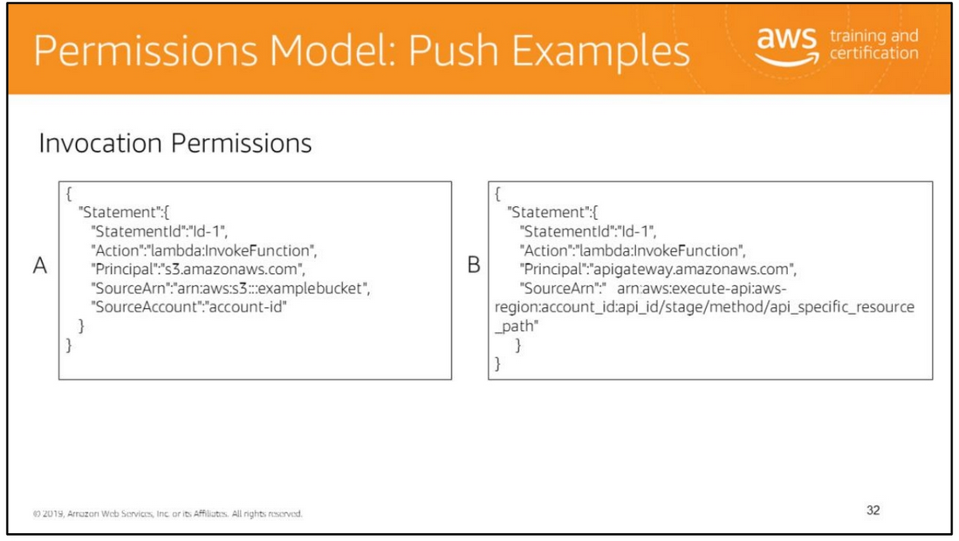
In Example A, Amazon S3 is being granted principal permission for the lambda:InvokeFunction action if the event source is examplebucket bucket,
and the bucket is owned by a specific AWS account.
In Example B, Amazon API Gateway is granting principal permission for the lambda:InvokeFunction action provided that the request is coming from your Amazon API Gateway API resource action.

Slide 35
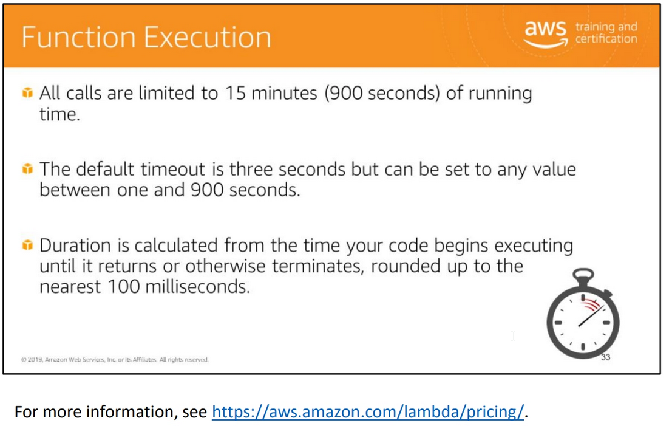

Slide 36
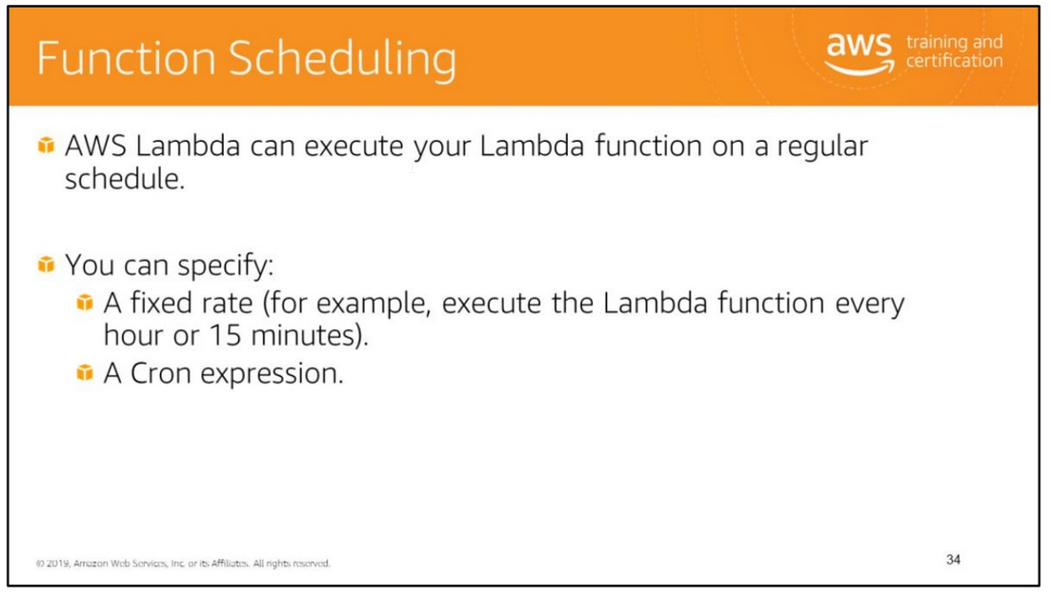
Scheduling a Lambda function using AWS Lambda is only available through the AWS Lambda console.
The console provides the Scheduled Event as an event source, which is chosen during creation of the function.
For more information, see http://docs.aws.amazon.com/lambda/latest/dg/getting-started-scheduled-events.htm

Slide 37
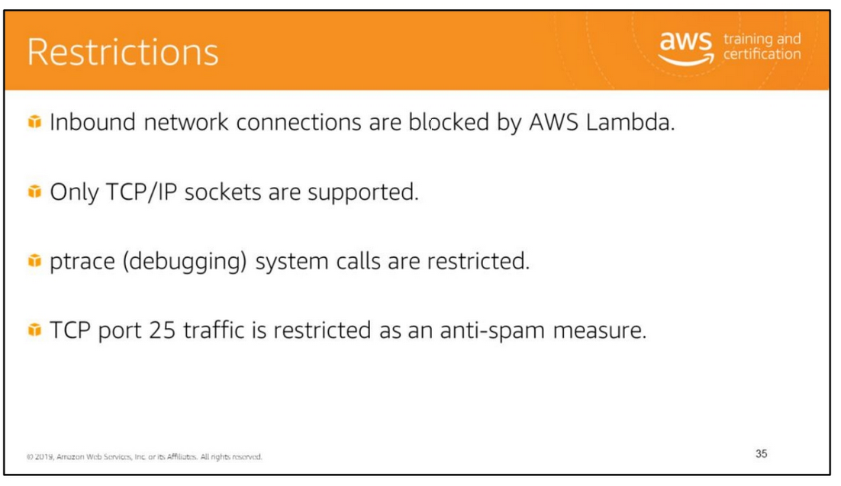
Lambda attempts to impose few restrictions on normal language and operating system activities; the restrictions are listed here.

Slide 38
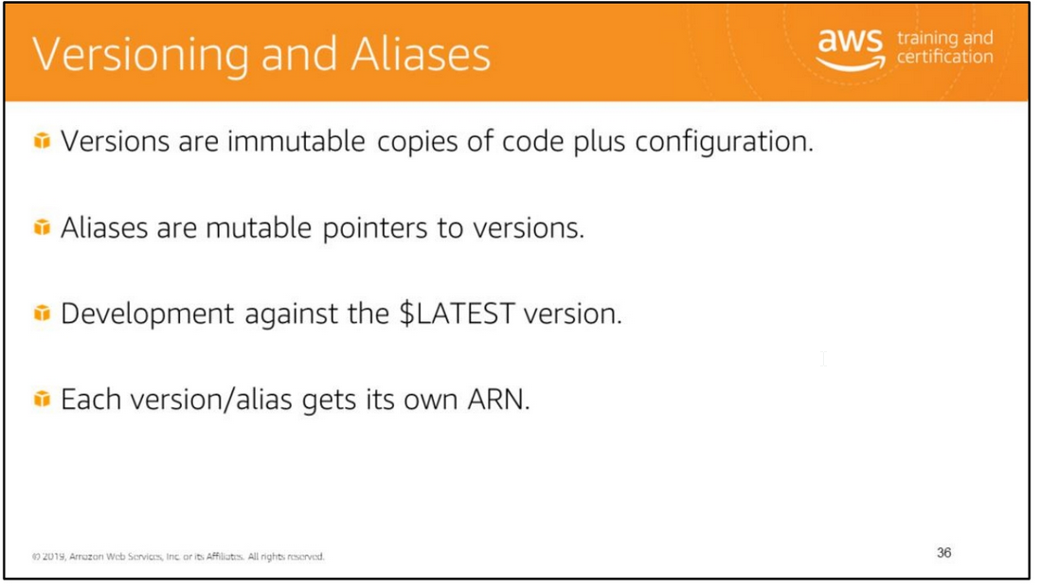
Versioning allows you to publish one or more versions of your Lambda function.
Each time you publish a version, AWS Lambda copies the $LATEST version (code and configuration) to create a new version.
When you publish additional versions, AWS Lambda assigns a monotonically increasing sequence number for versioning.
For more information on versioning, see http://docs.aws.amazon.com/lambda/latest/dg/versioning-intro.html.
You can create aliases for your Lambda function. An alias is a Lambda resource and has its own unique ARN.

Slide 39
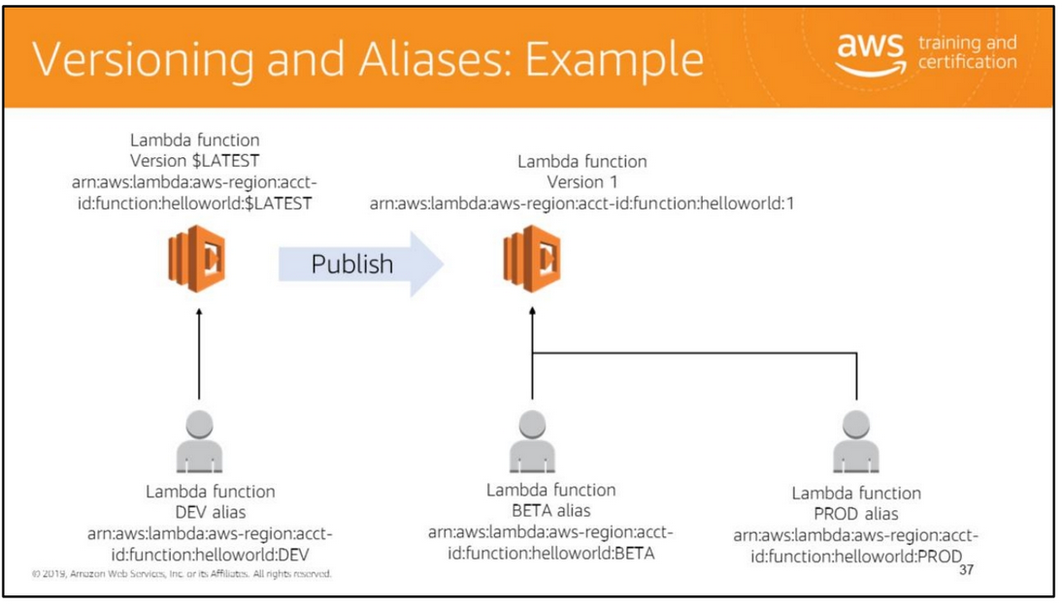
The diagram illustrates publication of a version from the $LATEST, with a BETA alias pointing to Version 1 to allow for testing.
After testing the BETA version, you can define a PROD alias to map to Version 1

Slide 40
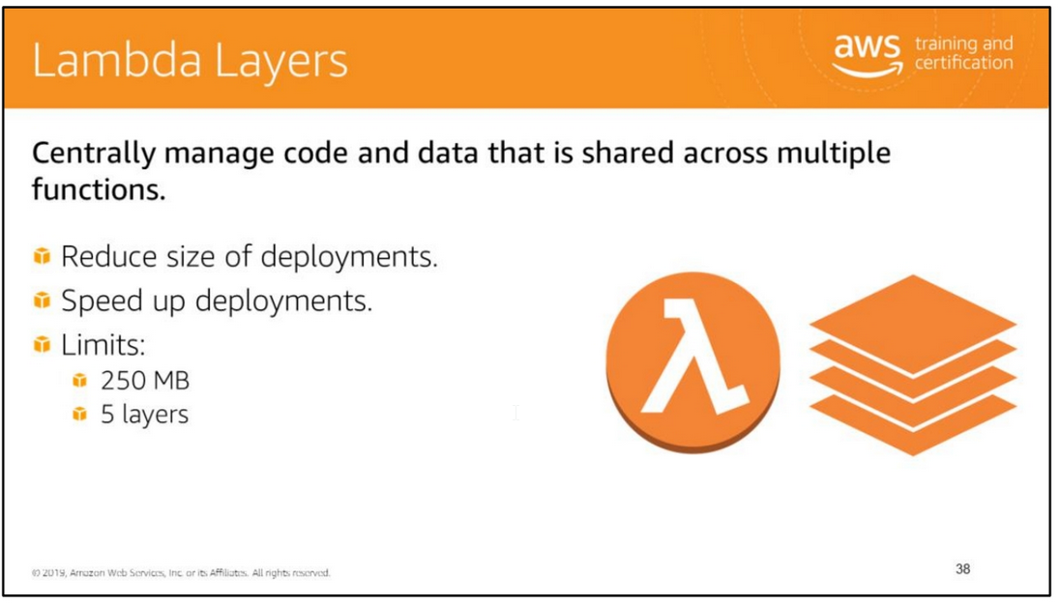
You can configure your Lambda function to pull in additional code and content as layers.
A layer is a ZIP archive that contains libraries, a custom runtime, or other dependencies.
With layers, you can use libraries in your function without needing to include them in your deployment package.
Layers let you keep your deployment package small, which makes development easier.
You can avoid errors that can occur when you install and package dependencies with your function code.
For Node.js, Python, and Ruby functions, you can develop your function code in the Lambda console as long as you keep your deployment package under 3 MB.
A function can use up to 5 layers at a time. The total unzipped size of the function and all layers can't exceed the unzipped deployment package size limit of 250 MB.
For more information, see AWS Lambda Limits.
You can create layers, or use layers published by AWS and other AWS customers.
Layers support resource-based policies for granting permission-specific AWS accounts, AWS Organizations, or all accounts.
Layers are extracted to the /opt directory in the function execution environment.
Each runtime looks for libraries in a different location under /opt, depending on the language.
Structure your layer so that function code can access libraries without additional configuration.
You can also use AWS Serverless Application Model (AWS SAM) to manage layers and your function's layer configuration.
For more information, see https://docs.aws.amazon.com/lambda/latest/dg/configuration-layers.html

Slide 41
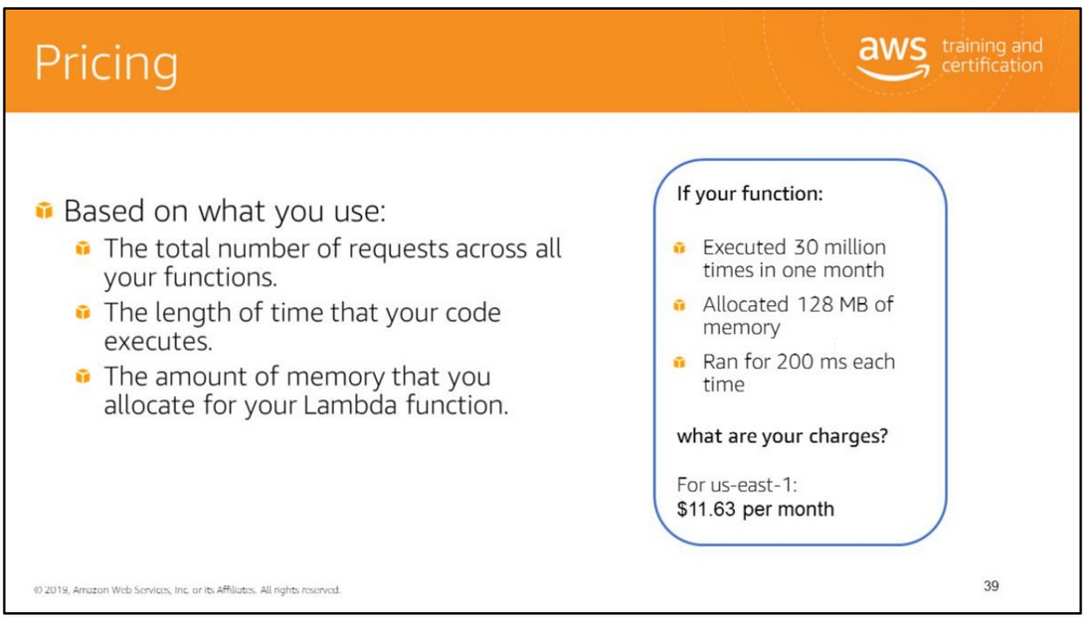
With AWS Lambda, you pay only for what you use. You are charged based on the number of requests for your functions and the duration, the time it takes for your code to execute.
Lambda counts a request each time it starts executing in response to an event notification or invoke call, including test invokes from the console.
You are charged for the total number of requests across all your functions.
Duration is calculated from the time your code begins executing until it returns or otherwise terminates, rounded up to the nearest 100 ms.
The price depends on the amount of memory you allocate to your function.
The Lambda free tier includes 1M free requests per month and 400,000 GB-seconds of compute time per month.
For more information, see https://aws.amazon.com/lambda/pricing/.

Slide 42


Slide 43
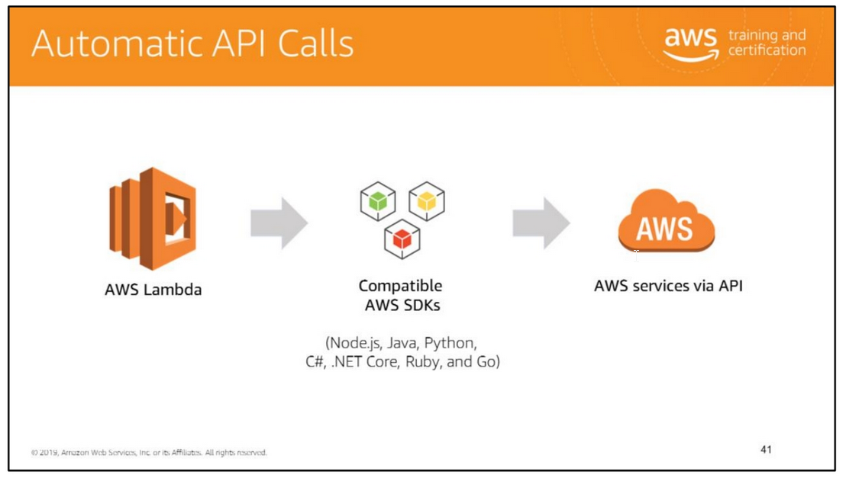
Scaling events can trigger AWS Lambda functions. In addition, code run in AWS Lambda has access to the AWS API and can grant permissions via AWS IAM roles.
Code run in AWS Lambda has access to the AWS API and can be granted permissions via AWS IAM roles.
Use a Lambda function to automatically make API calls to other AWS services when scaling happens.
This means you can use a Lambda function to automatically make API calls to other
AWS services when scaling happens.
Examples of scaling-related operations you could perform with AWS Lambda:
• Scale container-based instances (Docker, Amazon Elastic Container Service, etc.).
• Scale more intelligently using functions (for example, analyze a stream of performance data looking for patterns rather than only events).
• Since AWS Lambda can scale automatically, consider replacing some Amazon EC2 instances with Lambda functions where appropriate.

Slide 44
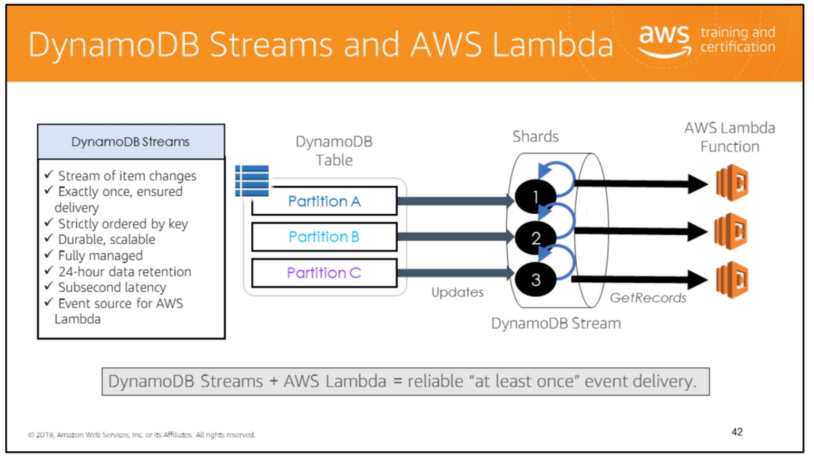
Amazon DynamoDB is integrated with AWS Lambda so that you can create triggers—pieces of code that automatically respond to events in DynamoDB Streams.
With triggers, you can build applications that react to data modifications in DynamoDB tables.
If you enable DynamoDB Streams on a table, you can associate the stream ARN with a Lambda function that you write
Immediately after an item in the table is modified, a new record appears in the table's stream.
AWS Lambda polls the stream and invokes your Lambda function synchronously when it detects new stream records.

Slide 45


Slide 46
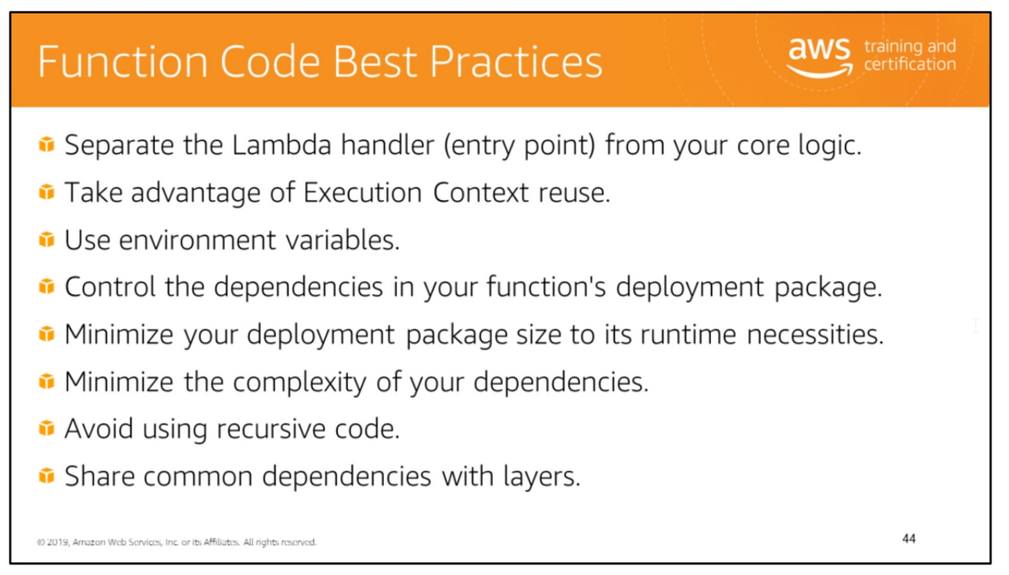

Slide 47
Separate the Lambda handler (entry point) from your core logic
This allows you to make a more unit-testable function.
Take advantage of Execution Context reuse to improve the performance of your function
Make sure any externalized configuration or dependencies that your code retrieves are stored and referenced locally after initial execution.
Limit the re-initialization of variables/objects on every invocation.
Instead use static initialization/constructor, global/static variables, and singletons.
Keep alive and reuse connections (HTTP, database, etc.) that were established during a previous invocation.
Use environment variables to pass operational parameters to your function
For example, if you are writing to an Amazon S3 bucket, instead of hardcoding the bucket name you are writing to, configure the bucket name as an environment variable.
Minimize your deployment package size to its runtime necessities
This reduces the amount of time that it takes for your deployment package to be downloaded and unpacked ahead of invocation. For functions authored in Java or
.NET Core, avoid uploading the entire AWS SDK library as part of your deployment package.
Instead, selectively depend on the modules that pick up components of the SDK you need (e.g., DynamoDB, Amazon S3 SDK modules, and Lambda core libraries.)
Minimize the complexity of your dependencies
Prefer simpler frameworks that load quickly on Execution Context startup.
For example, prefer simpler Java dependency injection (IoC) frameworks like Dagger or Guice, over more complex ones like Spring Framework.
Avoid using recursive code
Avoid using recursive code in your Lambda function, wherein the function automatically calls itself until some arbitrary criteria is met.
This could lead to unintended volume of function invocations and escalated costs.
If you do accidentally do so, set the function concurrent execution limit to 0 immediately to throttle all invocations to the function, while you update the code

Slide 48
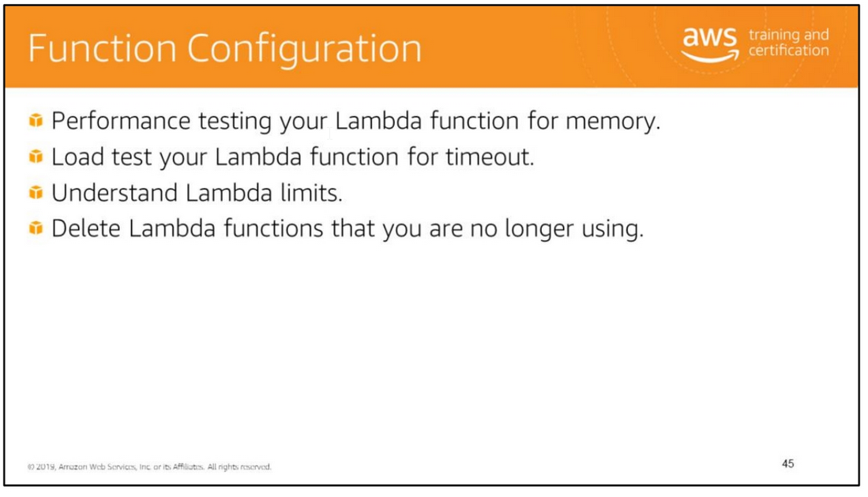

Slide 49
Performance testing your Lambda function is a crucial part in making sure that you choose the optimummemory size configuration. Any increase in memory size triggers an equivalent
increase in CPU available to your function. The memory usage for your function is determined per-invoke and can be viewed in Amazon CloudWatch Logs.
Load test your Lambda function to determine an optimum timeout value. It is important to analyze how long your function runs so that you can better determine any problems
with a dependency service that may increase the concurrency of the function beyond what you expect. This is especially important when your Lambda function makes network calls
to resources that may not handle Lambda's scaling.
Lambda Limits:
• Memory allocation range: Minimum = 128 MB / Maximum = 3008 MB (with 64-MB increments).
Ephemeral disk capacity ("/tmp" space) = 512 MB • RequestResponse/synchronous invocation payload size = 6 MB
• Event/asynchronous invocation payload size = 128 KB • Maximum execution duration per request 300 seconds (5 minutes)
• Invoke request body payload size (RequestResponse/synchronous invocation
NOTE: The response body payload also must adhere to this limit. 6 MB
• Invoke request body payload size (Event/asynchronous invocation)128 KB • Lambda function deployment package size (compressed .zip/.jar file) 50 MB
• Total size of environment variables set 4 KB
• Size of code/dependencies that you can zip into a deployment package (uncompressed .zip/.jar size).
Note: Each Lambda function receives an additional 512 MB of non-persistent disk space in its own /tmp directory.
The /tmp directory can be used for loading additional resources like dependency libraries or datasets during function initialization.
For more information, see https://docs.aws.amazon.com/lambda/latest/dg/limits.html

Slide 51
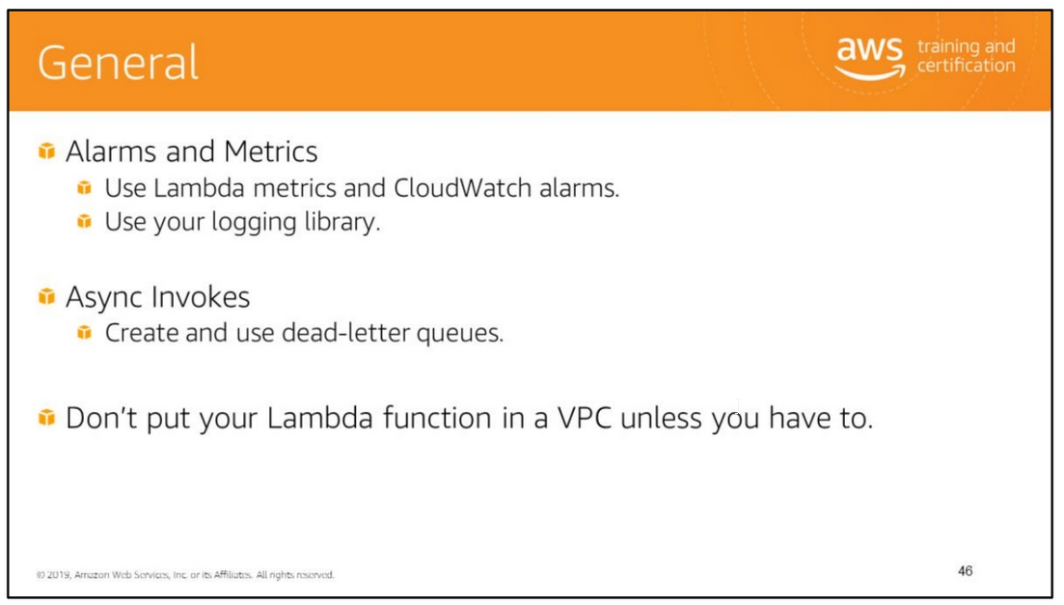
Use AWS Lambda metrics and CloudWatch alarms instead of creating or updating a metric from within your Lambda function code.
It's a much more efficient way to track the health of your Lambda functions, allowing you to catch issues early in the development process.
For instance, you can configure an alarm based on the expected duration of your Lambda function execution time in order to address any bottlenecks or latencies attributable
to your function code.
Leverage your logging library and AWS Lambda metrics and dimensions to catch app errors (e.g., ERR, ERROR, WARNING, etc.)
Don't put your Lambda function in a VPC unless you have to.
There is no benefit outside of using this to access resources you cannot expose publicly, like a private Amazon Relational Database instance. Services like Amazon Elasticsearch Service
can be secured over IAM with access policies, so exposing the endpoint publicly is safe and wouldn't require you to run your function in the VPC to secure it

Slide 52

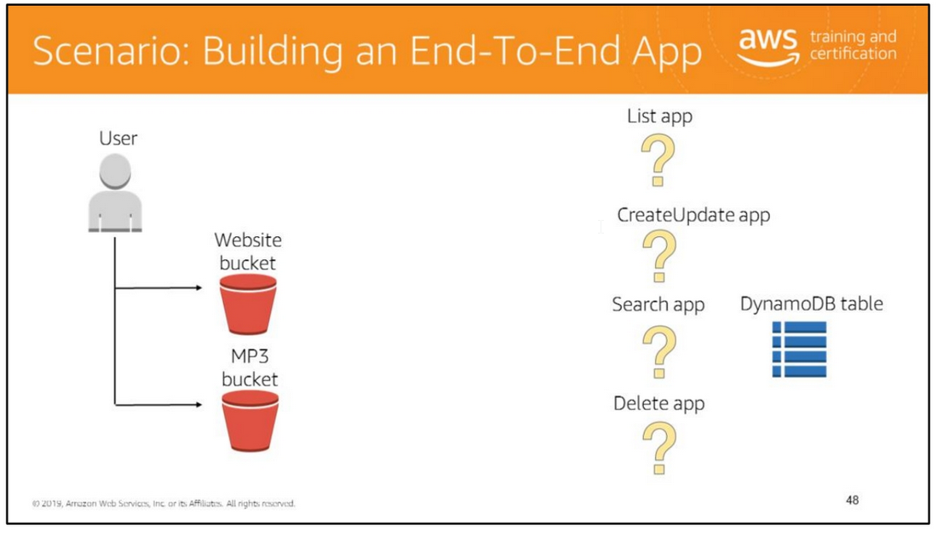
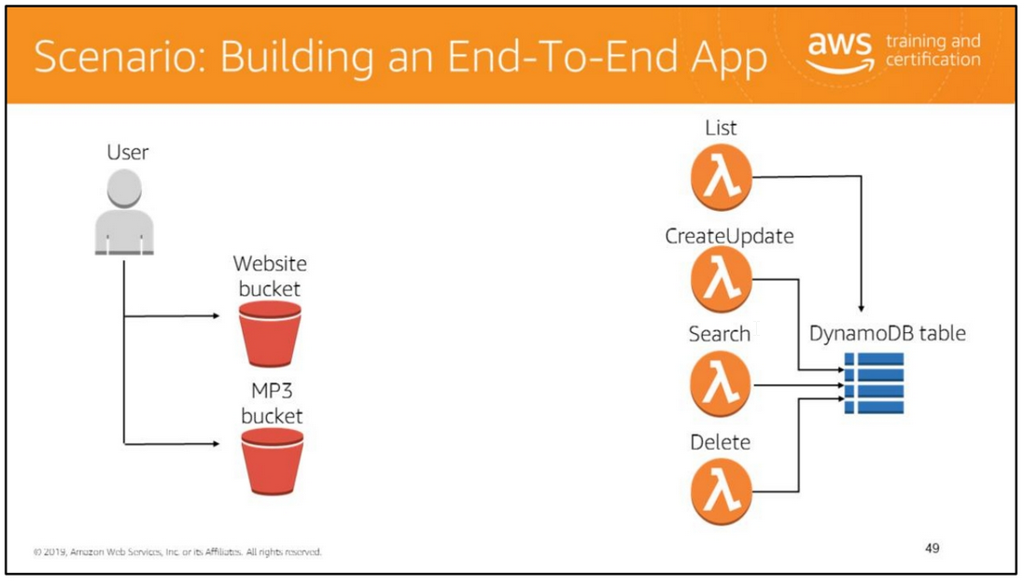

Slide 53

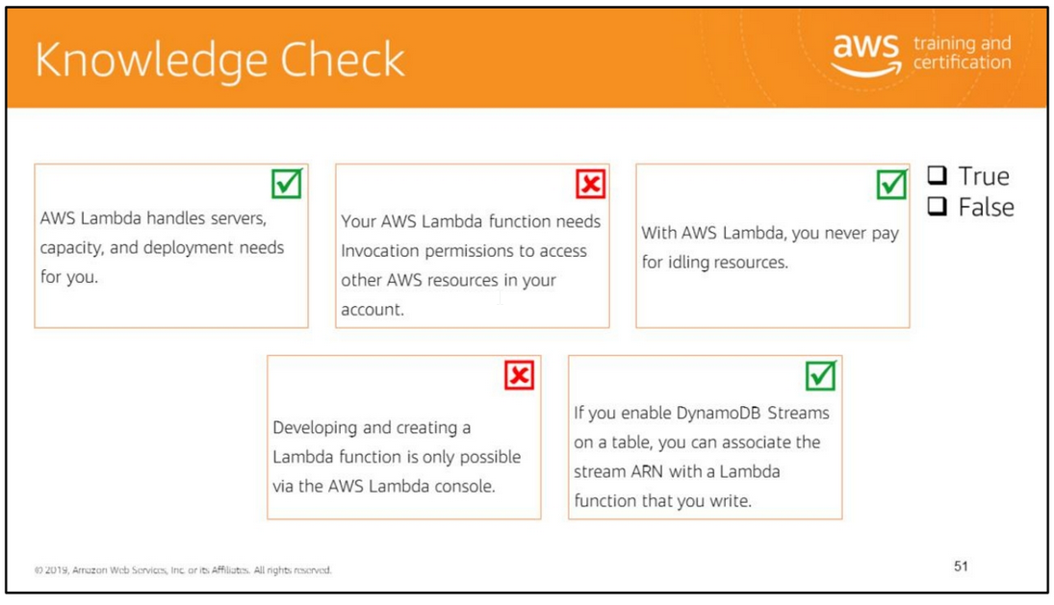
Read left to right:
(True)
(False) Your AWS Lambda function needs Execution permissions to access other AWS resources in your account.
(True)
(False) In addition to the AWS Lambda console, you can use the AWS CLI. You can also interact with your custom code using AWS SDKs. Plus, both Eclipse and Visual Studio toolkits have support to develop Lambda functions.
(True)
(False) A Lambda function consists of your code, associated dependencies, and configuration.

